Slide 1

Alpha College Of Engineering And Technology
College LOGO
Laravel-ticktalk (Employee and Project management system)
Prepared by:
Pathan Uvesh:
Guided by :
Prof. Liyanshi Patel

Slide 2
Introduction
The Tilk-Talk 2.0 platform allows employees to easily clock in and out and track their break times, streamlining time and attendance management. The HR module allows for the management of leaves, attendance, and holidays, as well as tracking employee data such as performance and skills.
The Work module provides features for managing projects, tasks, and time logs, making it easier to track progress and productivity.

Slide 3
Abstract
The Laravel-ticktalk is a software application designed to streamline and automate various aspects of employee management.
The system includes features such as clocking in and out, tracking breaks, managing attendance, leaves, and holidays, and organizing work-related information such as projects and reports.

Slide 4
Tools And Technology
Operating system: windows 7/8 and higher.
Front end: Android Studio(3.4.0.0)
Back end: Laravel (10)
Database: Mysql (8.0)
Platform: Any Browser
Other tools : Apache Server (2.4.57), notepad++.

Slide 5
Existing System
Basic interface with limited functionality.
Manual Clock-in process.
Limited scalability and sustainability.
No Time spent data was there.
Minimal Employee Management measures.
User get Limited Option.

Slide 6
New system
Intuitive and user-friendly interface.
Dashboard that allows employees to easily clock-in.
Cost-effective and sustainable repair process.
Centralized platform for HR to manage employee information.
Comprehensive Task Management.
Allow employees to track their time spent on.

Slide 7
Methodology
Step 1 : Login.
Step 2 : Clock-In / Clock-Out.
Step 3 : Break (Start / End).
Step 4 : Add / Manage (Leave).
Step 5 : Check project Status.
Step 6 : Manage Tasks.

Slide 8
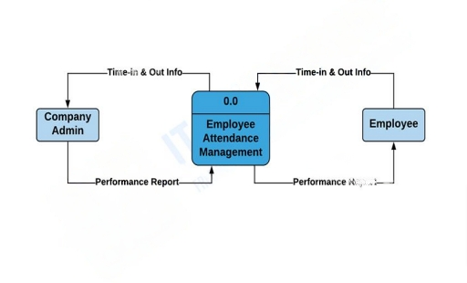
Data Flow Chart: (Level 1)

Slide 9
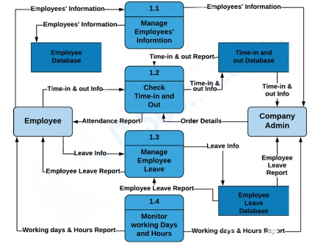
Data Flow Chart: (Level 2)

Slide 10
Module 1 Employee
This module is responsible for managing employee information, such as personal details, job information, and contact information. It also includes features such as clock-in/clock-out, break start/end, and leave requests.

Slide 11
Module 2 HR (Admin)
The HR module is responsible for managing attendance, leaves, and holidays for employees. It includes features such as managing employee data, leave requests, attendance tracking, and holiday schedules.

Slide 12
Module 3 Team Lead (Manager)
The team lead module is responsible for managing team information, including team member details, project information, and project timelines. It includes features such as task assignment, progress tracking, and communication tools for interacting with team members.

Slide 13
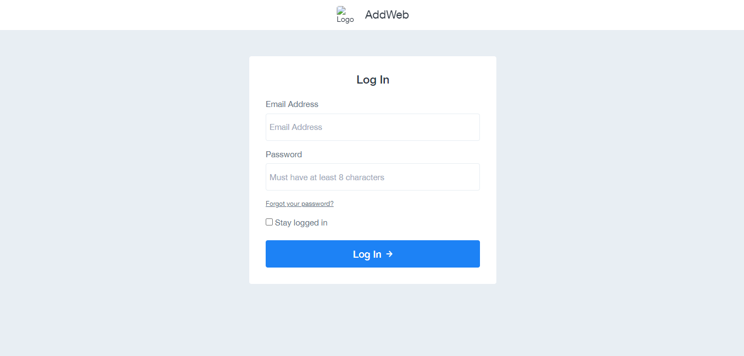

Slide 14
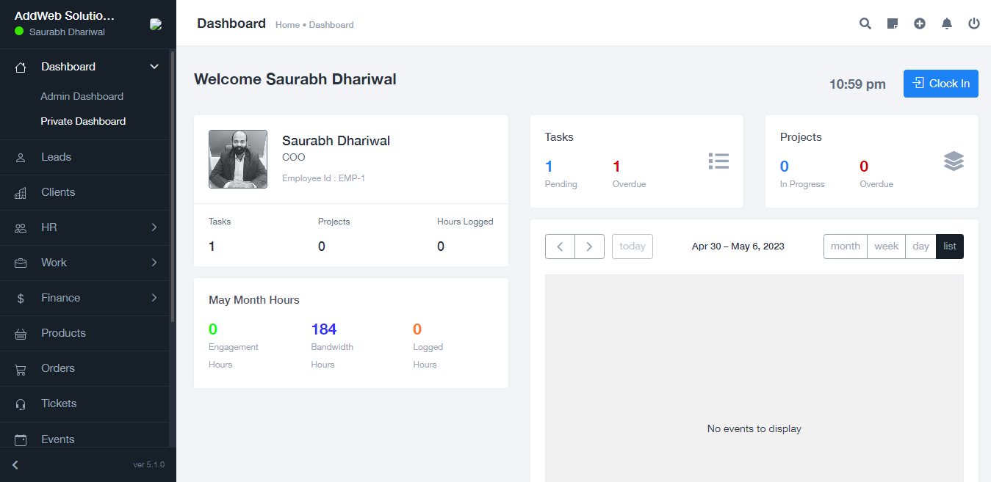

Slide 15
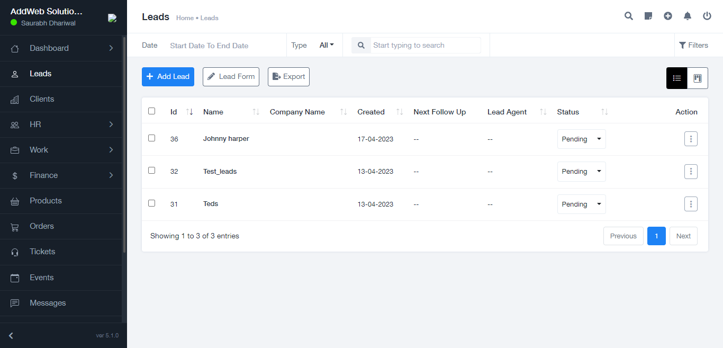

Slide 16
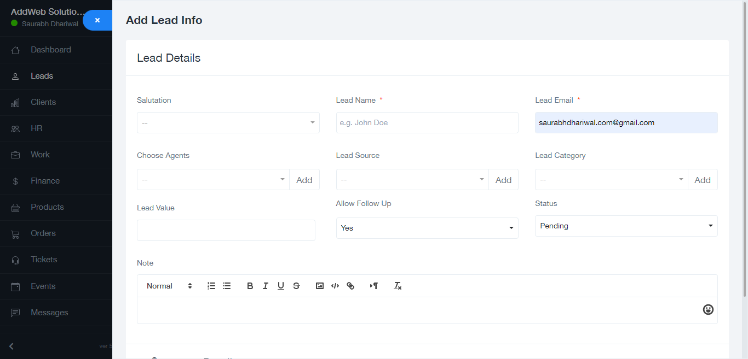

Slide 17
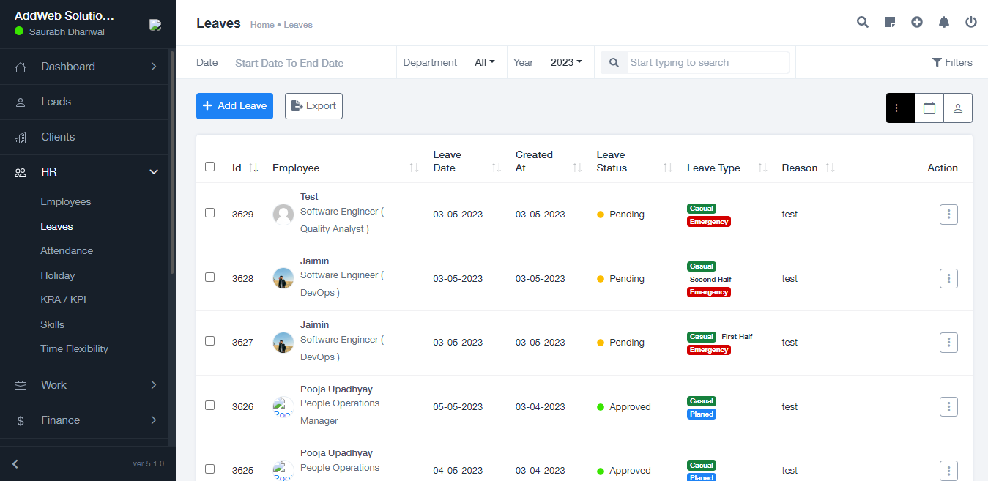

Slide 18
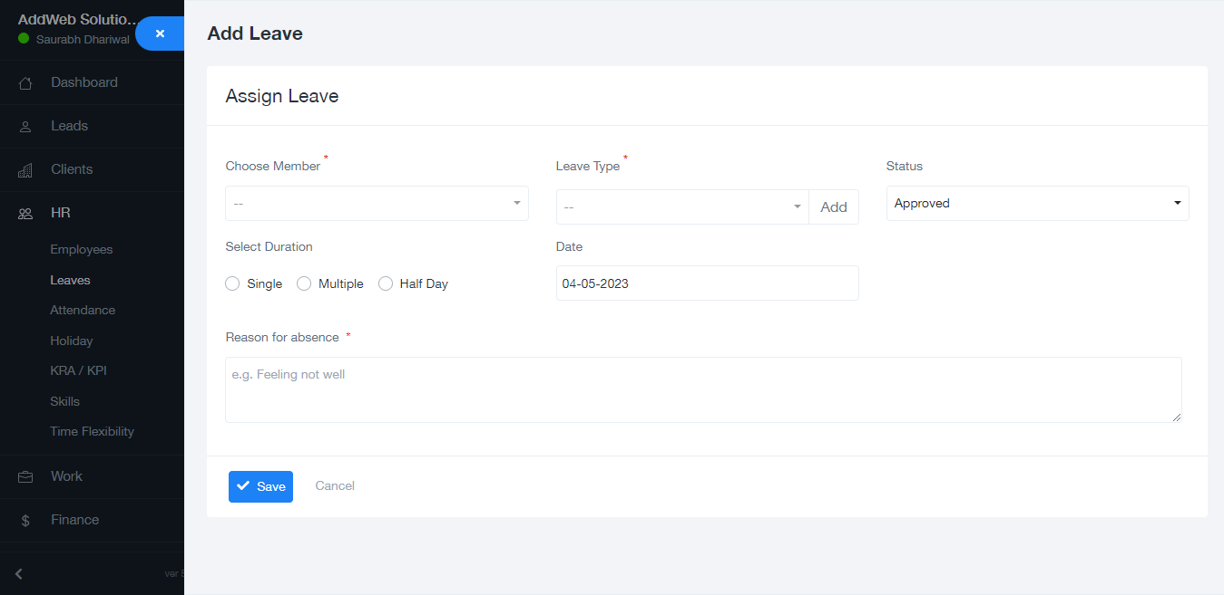

Slide 19
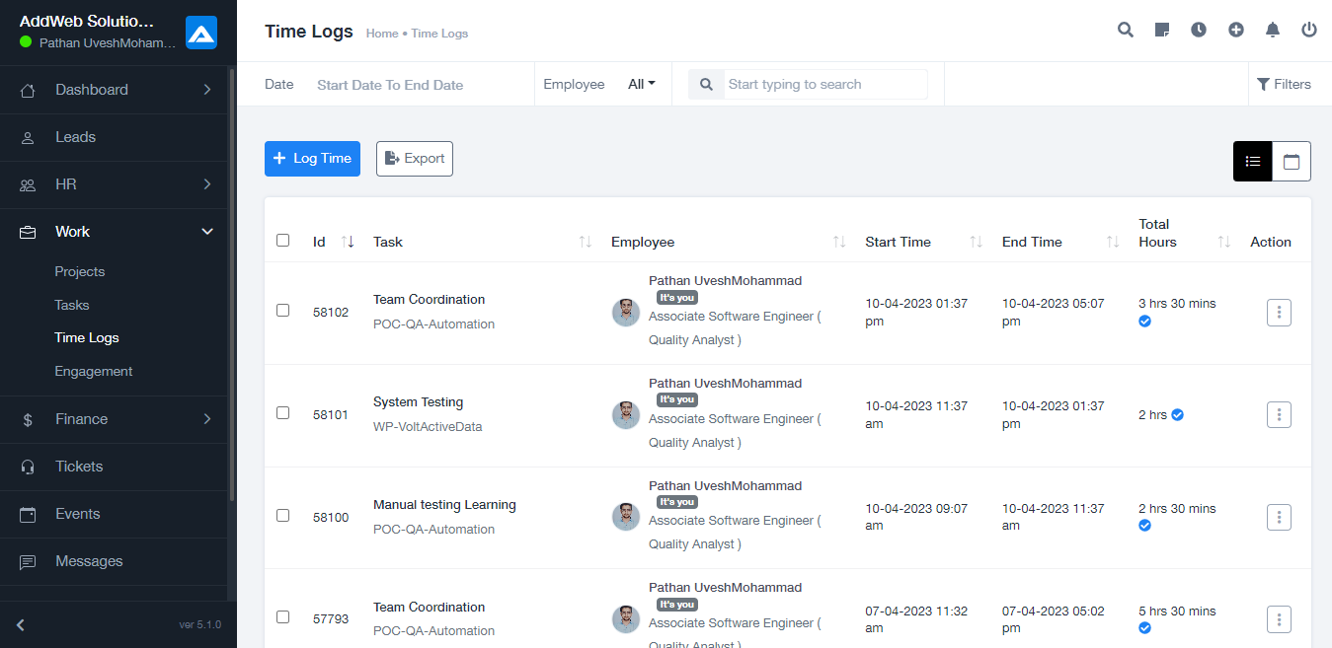

Slide 20
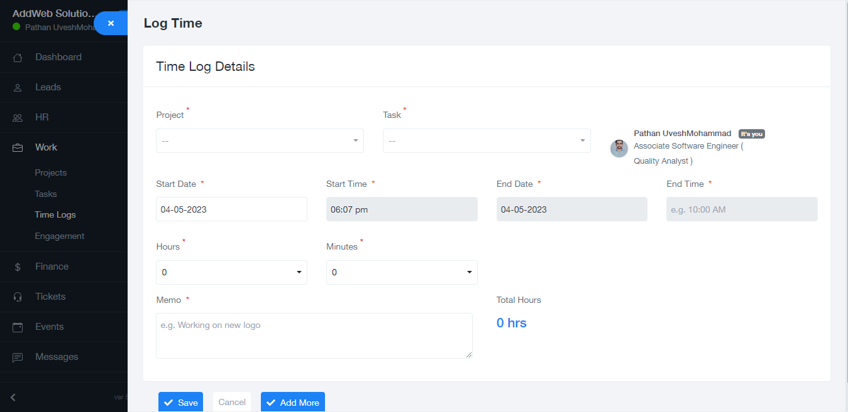

Slide 21
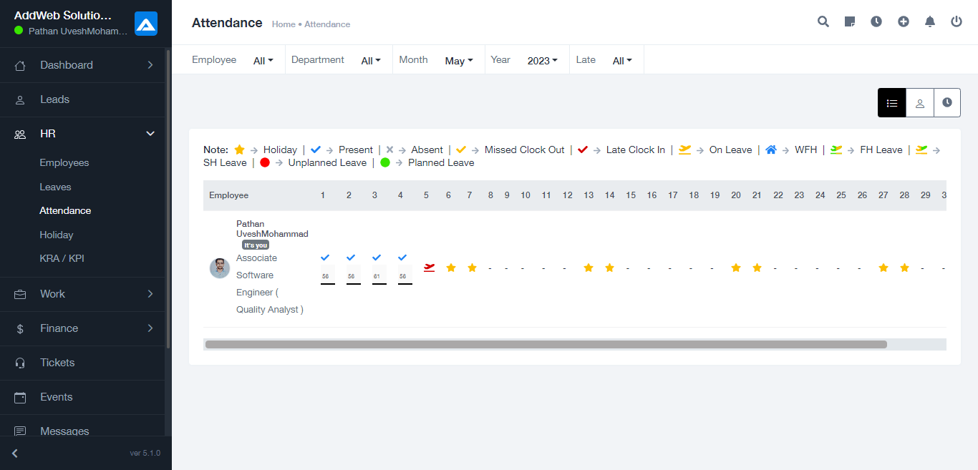

Slide 22
Conclusion
In conclusion, the Laravel-ticktalk is a comprehensive web application designed to streamline and automate various aspects of employee management.
Overall, the Laravel-ticktalk is a valuable tool for organizations looking to improve their workforce management practices and increase productivity.

